Slide 1
CPSC 5200
Software Architecture and Design

Slide 2
UML, before we start

Slide 3
UML vs Design Principles
UML is simply a standardized visual model language
Knowing it doesn’t teach you how to think in objects
UML is sometimes called a design tool, but that’s not right either
The critical design tool for software development is a mind well educated in design principles.

Slide 4
UML overview

Slide 5
Overview of UML
UML approach comprises several views and models addressing
Static and Dynamic modeling views
UML syntax & semantics are defined via
A metamodel
A model that specifies abstract syntax & semantics of UML
Descriptive text
Constraints

Slide 6
UML tools
StarUML (for Win32 and MacOS platforms)
Comprehensive set of UML Designers
http://en.wikipedia.org/wiki/List_of_UML_tools
Visio
Sparx Enterprise Architect (my personal favorite)
Paradigm Plus

Slide 7
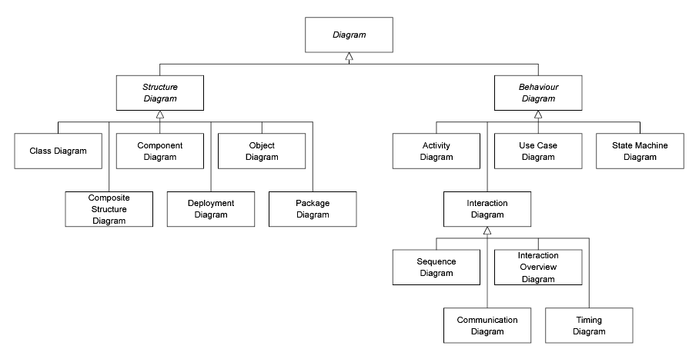
UML 2.0 diagrams in UML

Slide 8
The basics
Actors: a UML actor indicates an interface (point of interaction) with the system
Used to group and name sets of system interactions
May be people, or other systems
An actor is NOT part of the system you are modeling – something external that your system has to deal with
Boxes: boxes have a variety of meanings in different UML diagrams indicating discrete elements, groupings and containment.

Slide 9
More basics
Arrows: Different meanings in different diagrams. Usually, indicate flow, dependency, association or generalization
Cardinality: applied to arrows, show relative numerical relationships between elements in a model: 1 to 1, 1 to many, etc.
Constraints: allow notation of arbitrary constraints on model elements. e.g., to constrain the value of a class attribute (a piece of data)
Stereotypes: allow us to extend the semantics of UML with English. A stereotype is usually a word or short phrase that annotates what a diagram element to better describe what it does( <<>>).
Stereotypical role for the element. Should always be applied consistently (with the same intended meaning in all instances).

Slide 10
Structural modeling diagrams
Define the static architecture of a model
Model the 'things' that make up a model
classes, objects, interfaces and physical components
Model the relationships and dependencies between elements
Package diagrams
Used to divide the model into logical containers, or 'packages', and describe the interactions between them at a high level
Class or Structural diagrams
Define the basic building blocks of a model: the types, classes and general materials used to construct a full model

Slide 11
Structural modeling diagrams 2
Object diagrams
Show how instances of structural elements are related and used at run-time
Composite Structure diagrams
Provide a means of layering an element's structure and focusing on inner detail, construction and relationships
Component diagrams
Used to model higher level or more complex structures, usually built up from one or more classes, and providing a well defined interface
Deployment diagrams
Show the physical disposition of significant artifacts within a real-world setting

Slide 12
Behavioral modeling diagrams
Capture the varieties of interaction and instantaneous states within a model as it 'executes' over time
Tracking how the system will act in a real-world environment, and observing the effects of an operation or event, including its results.
Use Case diagrams: used to model user/system interactions. They define behavior, requirements and constraints in the form of scripts or scenarios.
Activity diagrams: have a wide number of uses, from defining basic program flow, to capturing the decision points and actions within any generalized process.
State Machine diagrams: are essential to understanding the instant to instant condition, or "run state" of a model when it executes

Slide 13
Behavioral modeling diagrams 2
Communication diagrams: show the network, and sequence, of messages or communications between objects at run-time, during a collaboration instance
Sequence diagrams: are closely related to communication diagrams and show the sequence of messages passed between objects using a vertical timeline
Timing diagrams: use sequence and state diagrams to provide a view of an object's state over time, and messages which modify that state.
Interaction Overview diagrams: fuse activity and sequence diagrams to allow interaction fragments to be easily combined with decision points and flows

Slide 14
Structural modeling

Slide 15
Modeling structures
<<component>>
Component A
Component A
Component B
Provided
interface
Required
interface
Components are building blocks
Higher level of abstraction than the class diagrams
Each component is implemented by one or more classes at runtime

Slide 16
Ports
A port is a typed element that represents an externally visible part of a containing classifier instance
Ports on component diagrams allows for a service or behavior to be specified to its environment as well as a service or behavior that a component requires.
Ports may specify inputs and outputs as they can operate bi-directionally.

Slide 17
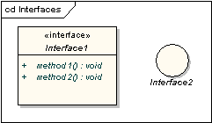
Ports and interfaces
Component B
Interface 1, Interface 2
Interface 3

Slide 18
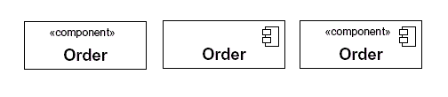
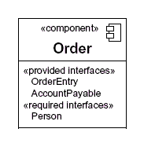
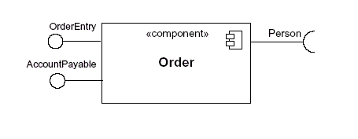
Example: components
Alternative ways to depict components
Alternative ways to depict interfaces

Slide 19
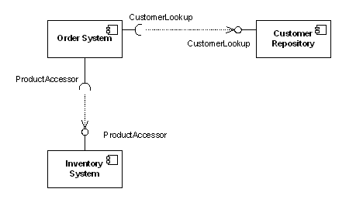

Example: relationships
Depicting Subsystems

Slide 20
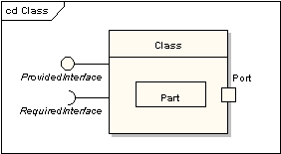
Composite structure diagram
Shows the internal structure of a classifier, including its interaction points to other parts of the system.
A part is an element that represents a set of one or more instances which are owned by a containing classifier instance.
A port is a typed element that represents an externally visible part of a containing classifier instance.

Slide 21
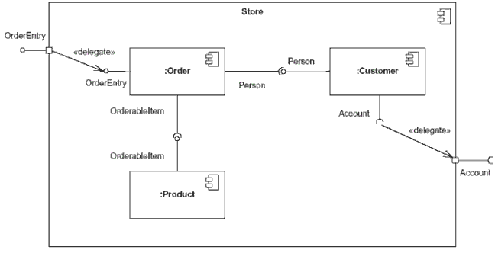
Example: inner structure

Slide 22
Class diagrams
Motivated by Object-Oriented design and programming concepts
A class diagram partitions the system into areas of responsibility (classes), and shows “associations” (dependencies) between them.
Attributes (data), operations (methods), constraints, part-of (navigability) and type-of (inheritance) relationships, access, and cardinality (1 to many) may all be noted.

Slide 23
Class diagram perspectives
Class diagrams can make sense at three distinct levels, or perspectives
Conceptual: the diagram represents the concepts in the project domain. That is, it is a partitioning of the relevant roles and responsibilities in the domain.
Specification: shows interfaces between components in the software. Interfaces are independent of implementation.
Implementation: shows classes that correspond directly to computer code (often Java or C++ classes). Serves as a blueprint for an actual realization of the software in code.

Slide 24
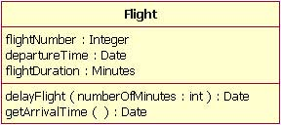
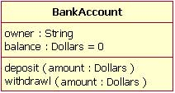
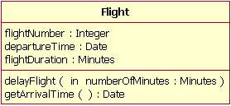
Example
Class Name
Attributes name and type
Operations
Attributes may have default
values
Optional “in” or “out” designation
present if the parameter is input
or output

Slide 25
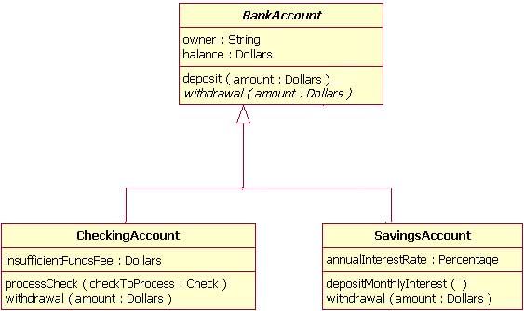
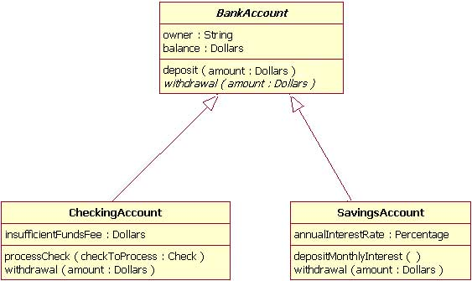
Example: inheritance
(alternative)
Notes:
Tree form

Slide 26
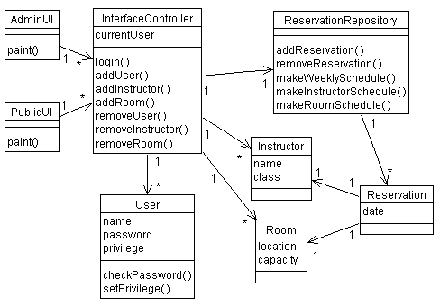
Class diagram examples (A classroom scheduling system: specification perspective.)
Cardinality
Directions
Notes:
Each box is a class, with necessary attributes and operations specified.
Navigability arrows show which classes can reference which others.
Cardinality marked in bi-directional manner on arrows.
The classes together represent the complete system; thus the the classes are a partitioning of the system.

Slide 27
Package diagram
A type of class diagram, package diagrams show dependencies between high-level system component.
A “package” is usually a collection of related classes, and will usually be specified by its own class diagram.
The software in two distinct packages is separate; packages only interact through well-defined interfaces, there is no direct sharing of data or code.
Not all packages in a system’s package diagram are new software; many packages (components) in a complex system are often already available as existing or off-the-shelf software.

Slide 28
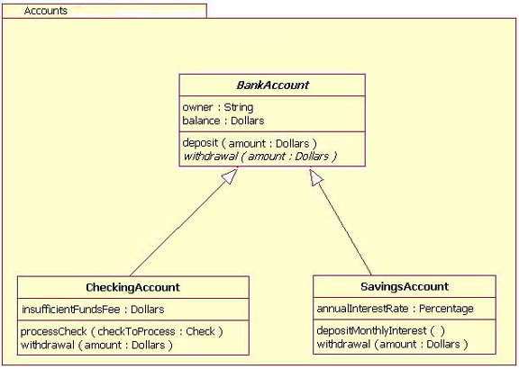
Example: package diagram

Slide 29
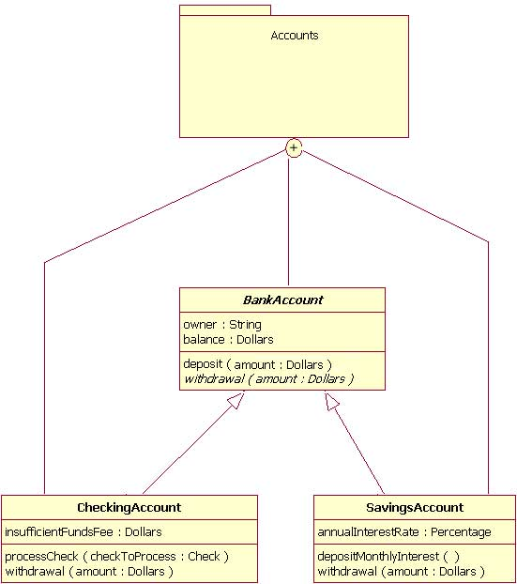
Alternative

Slide 30
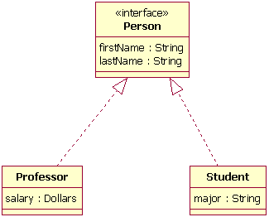
Example

Slide 31
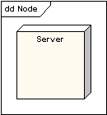
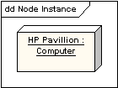
Deployment diagram
Models the run-time architecture of a system
Shows the configuration of the hardware elements (nodes) and how software elements are mapped onto those nodes

Slide 32
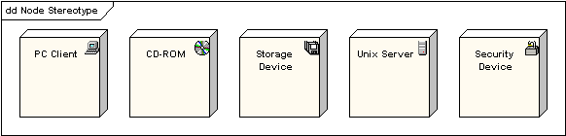
Cont.

Slide 33
Behavioral Diagrams

Slide 34
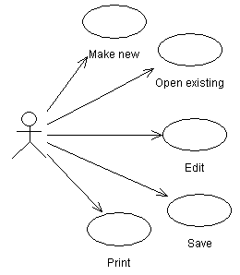

Use case example
Lower-level use case
High-level use case

Slide 35
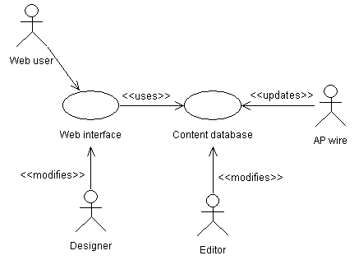
Another use case example (Relationships in a news web site.)
Notes:
The last is more complicated and realistic use case diagram. It captures several key use cases for the system.
Note the multiple actors. In particular, ‘AP wire’ is an actor, with an important interaction with the system, but is not a person (or even a computer system, necessarily).
The notes between << >> marks are stereotypes: identifiers added to make the diagram more informative. Here they differentiate between different roles (ie, different meanings of an arrow in this diagram).

Slide 36
Sequence diagram
Sequence diagram describe algorithms, though usually at a high level: the operations in a useful sequence diagram specify the “message passing” (method invocation) between objects (classes, roles) in the system.
The notation is based on each object’s life span, with message passing marked in time-order between the objects. Iteration and conditional operations may be specified.
May in principle be used at the same three levels as class diagrams, though the specification level will usually be most useful. (At the implementation level, you might better use pseudocode.)

Slide 37
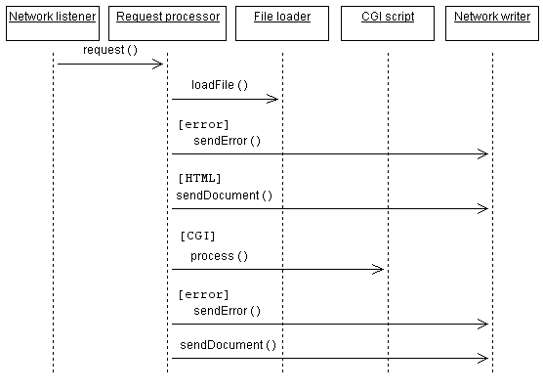
Example: sequence diagram
Each box with connected line represents a distinct thing, where all the things are not necessarily in the same piece of software, or software at all.
Arrows indicate message passing.
Reverse arrows are implied.
Time runs down the page. An comes before an arrow that is below it.
Brackets indicate conditions.
Notes:
Each box with connected line represents a distinct thing, where all the things aren’t necessarily in the same piece of software, or software at all.
Arrows indicate message passing. That is, an arrow indicates that one thing tells another thing to do something.
Reverse arrows are implied. If arrow goes from A to B, and then immediately afterward an arrow goes from A to something else, it is understood that B completed it’s operation and returned control (and a result, probably) to A.
Time runs down the page. An comes before an arrow that is below it.
Bracketed expressions indicate conditions. In the diagram, an error document is returned if the fileLoad() operation returns and error.

Slide 38
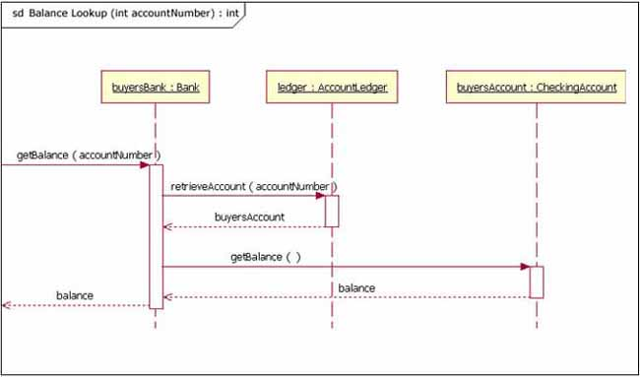
Example: sequence diagram (with incoming and outgoing messages)

Slide 39
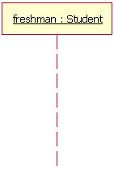
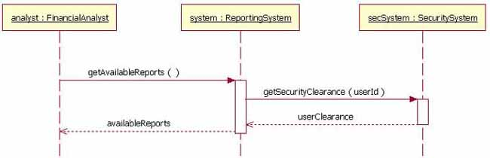
Basics
Instance Name : Class Name
Lifeline
Notes:
Goal of SD: define event sequences that result in some desired outcome – focus on order
These return messages are optional; a return message is drawn as a dotted line with an open arrowhead back to the originating lifeline

Slide 40
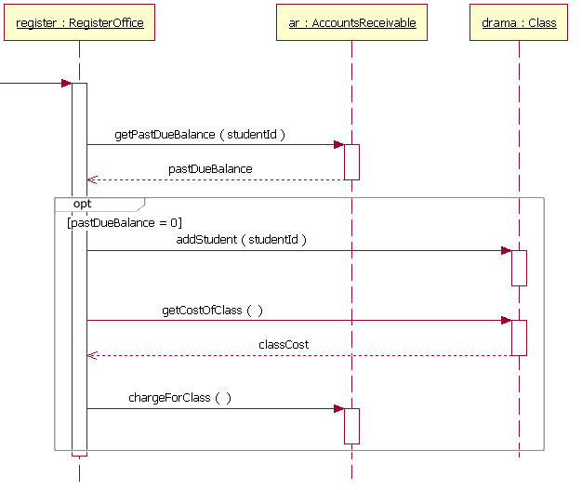
Optional or Loop

Slide 41
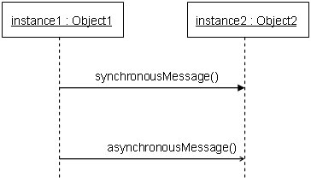
Synchronous vs. Asynchronous Message

Slide 42
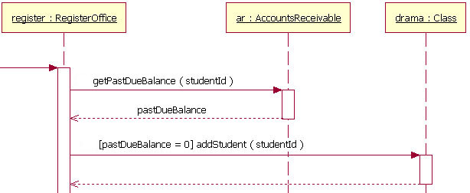
Guards

Slide 43
Other diagrams
State diagrams: similar in function to sequence diagrams, but with focus on the prerequisites for an operation, rather than the exact sequence of actions.
Others: activity diagrams, collaboration diagrams.
Look in UML Distilled for examples.
Look at www.uml.org for specification

Slide 44
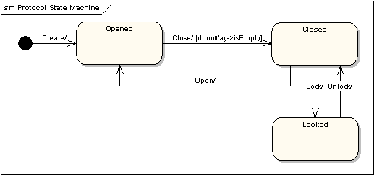
State machines
Shows the lifecycle of an object
What events it experiences, its transitions and the states it is in between these events.
Represents interesting events and states of an object
And the behavior of the an object in reaction to events
Bubbles – states
Initial state
Arrows – transitions

Slide 45
Definitions
Event: a significant or noteworthy occurrence
E.g., button pushed, telephone is removed from receiver, car is turned on, student is registered, student has graduated, …
State: condition of an object at a moment in time
e.g., telephone is in the state of being idle after received is placed on the hook and until it is taken off the hook
Transition: a relationship between two state that indicates that when an event occurs the object moves from a prior state to the subsequent state
E.g., car is turned off, key is turned and ignition started, car is turned on

Slide 46
State machine applications
To model the behavior of a complex reactive object in response to events
To model legal sequence of operations – protocols or language specifications

Slide 47
Syntax
Events [conditions]/actions
All are optional but you need to understand why
Examples:
Gas station
Model sequence of operations when you fill the gas tank of your car
Model webpage navigation for course registration
Model a cruise control system in a car

Slide 48
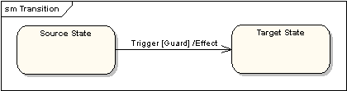
State machine semantics

Slide 49
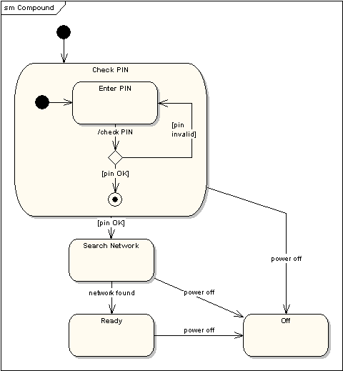
Example

Slide 50
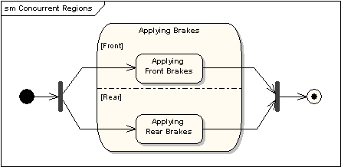
Example: concurrency

Slide 51
More information
UML 2.5.1 specification
https://www.omg.org/spec/UML

